Slide 1



Slide 2


Data lakes: Easily build, secure, and share data with AWS Lake Formation
A N T 3 1 8
Chanu Damarla (he/him)
Principal Product Manager AWS Lake Formation
James R Reid (he/him)
CIO of Employee Experience and Corporate Technology JPMorgan Chase
Anu Jain (she/her)
MD of Consumer & Community Banking JPMorgan Chase
© 2021, Amazon Web Services, Inc. or its affiliates. All rights reserved.

Slide 3
AGENDA
Why data lakes
Challenges with building data lakes AWS Lake Formation overview
Why JPMorgan Chase chose AWS Lake Formation
How JPMorgan Chase built a data mesh using AWS Lake Formation Conclusion

Slide 4
Customers want more value from their data
Growing exponentially
From new sources
Increasingly diverse
Used by many people
Analyzed by many applications

Slide 5









Customers are moving from
Siloed data Modern data architectures
Amazon Aurora
Amazon EMR
Business
intelligence
Business intelligence
Amazon
OpenSearch
Service
Amazon
DynamoDB
…
Amazon Athena
Amazon S3
DW Silo
Hadoop Silo
OLTP ERP CRM LOB
Devices Web sensors Social
Amazon Redshift
Amazon SageMaker

Slide 6


Data lake: Scalable and secure
A flexible, secure repository that enables you to govern, discover, share, and analyze structured and unstructured data at any scale with the tool of your choice
Data lake

Slide 7
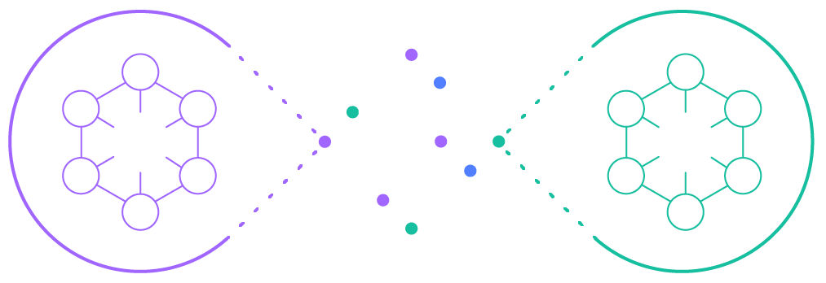
Data mesh: Governed sharing of data products
Architecture that enables the governed sharing of
data products across one-or-more data lakes
Data producers
Data mesh
Data consumers

Slide 8


















































More data lakes & analytics than anywhere else
H U N D R E D S O F | T H O U S A N D S | O F | D A T A | L A K E S R U N | O N | A W S | A C R O S S | A L L | I N D U S T R I E S
AMGEN | BMW GROUP
expedia group
inTuiT
NTT
docomo
TOYOTA

Slide 9
AGENDA
Why data lakes
Challenges with building data lakes
AWS Lake Formation overview
Why JPMorgan Chase chose AWS Lake Formation
How JPMorgan Chase built a data mesh using AWS Lake Formation Conclusion

Slide 10




Challenges in building data lakes
Challenge #5: Data sharing
Sharing across accounts and organizations is cumbersome.
Challenge #2: Data management
Managing how data is stored and optimized in S3 is time consuming.
AWS Glue ETL
On-premises
Streams
Amazon Redshift Spectrum
Amazon S3
AWS Glue Data Catalog
Amazon Athena
Databases
Logs
Amazon SageMaker
Amazon EMR
Challenge #1: Data Ingestion
Building reliable ingestion pipelines is complex.
Challenge #3: Security & governance
Managing permissions at scale is difficult and error-prone.
Challenge #4: Integrations
Hard to securely integrating the service of your choice.

Slide 11
Building and securing data lakes can take
months

Slide 12
AGENDA
Why data lakes
Challenges with building data lakes
AWS Lake Formation overview
Why JPMorgan Chase chose AWS Lake Formation
How JPMorgan Chase built a data mesh using AWS Lake Formation Conclusion

Slide 13











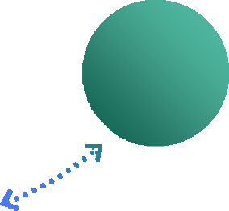


AWS Lake Formation
B U I L D A S E C U R E D A T A L A K E I N D A Y S
Build data lakes quickly
Move, store, and catalog your data faster
Amazon Aurora
Amazon Amazon
EMR DynamoDB
Amazon _{Amazon}
Elasticsearch _{SageMaker}
Service
Amazon Redshift
Simplify security management
Centrally define security, governance, and auditing policies in one place
Provide self-service access to data
Build a catalog of datasets
Define user access policies

Slide 14


















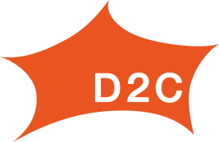








Using AWS Lake Formation

Slide 15
Challenge: Data ingestion & management
Challenge #2: Data management
Managing how data is stored in S3 is time consuming.
AWS Glue ETL
On-premises
Streams
Amazon Redshift Spectrum
Amazon S3
AWS Glue Data Catalog
Amazon Athena
Databases
Logs
Amazon SageMaker
Amazon EMR
Challenge #1: Data Ingestion
Building reliable ingestion pipelines is complex.

Slide 16




Why is data ingestion and management hard?
Continuous updates
Inconsistent performance
Complying with
regulations
Complex ETL
Data stored how it arrived
Difficult to find needle in very large haystack
Delays in data freshness
Lots of small files
Expensive, brittle, and error prone
Partition updates

Slide 17

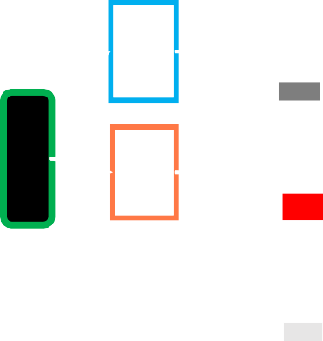


AWS Lake Formation Governed Tables
S I M P L I F Y D A T A I N G E S T I O N A N D D A T A M A N A G E M E N T
NEW!
ACID
ACID transactions
Consistent across tasks Insert, update, delete Converge batch & real-time
Storage optimization
Auto-compact small files Push-down filters Reduce data scan
Time travel
Data history Reproduce experiments
Audit changed data
Reliable
Performant
Versioned

Slide 18






Governed Tables
NEW!
Apache Hive-style tables
organize data in partitions
Governed Table
Americas
manifest
2018
Lake
Formation
Path
Oct.
Nov.
Dec.
29
30
1
Amazon S3
File
S3://IOTDeviceData/region=Americas/year=2021/month=Nov/day=30/data1.csv S3://IOTDeviceData/region=Americas/year=2021/month=Nov/day=30/data2.csv S3://IOTDeviceData/region=Americas/year=2021/month=Nov/day=30/data3.csv
…
Parquet, CSV, JSON, …
Import and export: Metadata only
© 2021, Amazon Web Services, Inc. or its affiliates. All rights reserved.

Slide 19




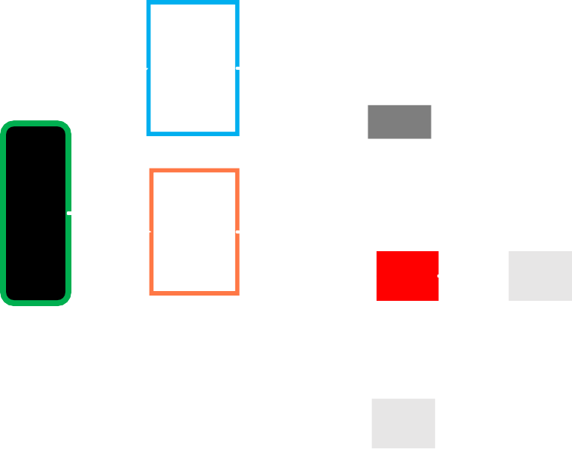
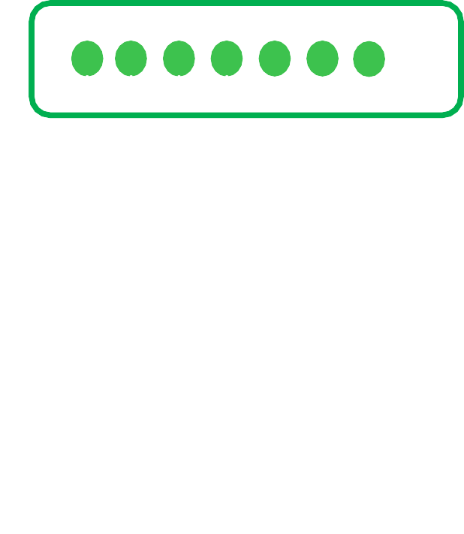
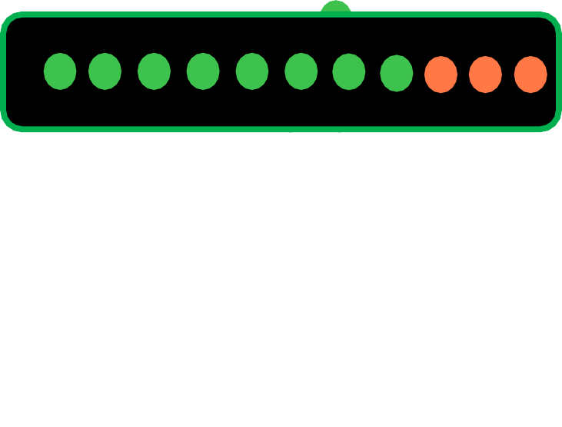
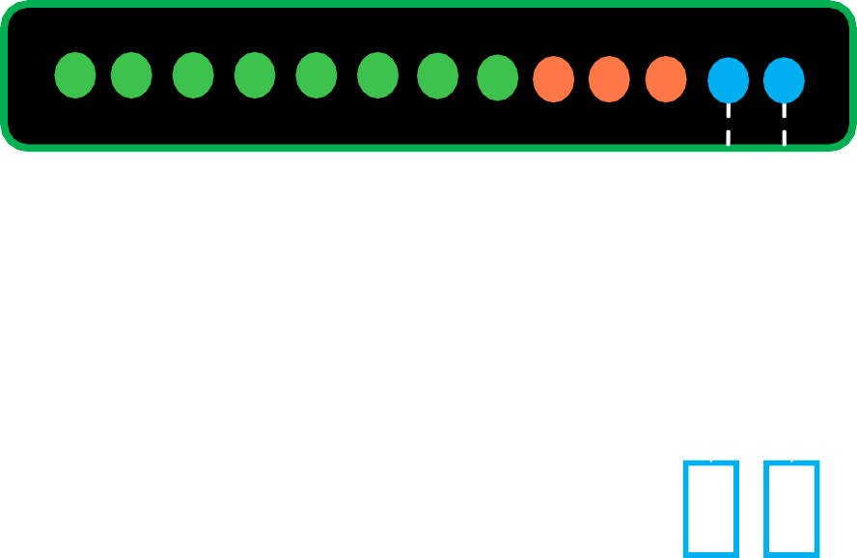
Governed Tables: Access and update APIs
NEW!
Add or remove files
T1
T2
Insert, update, delete rows
Manifest
T3
base S3 files
delta files
Time travel to previous version is instant
Now GA, w/ support in
Amazon Athena, AWS Glue, and Amazon Redshift Spectrum
© 2021, Amazon Web Services, Inc. or its affiliates. All rights reserved.

Slide 20













Without transactions and storage optimization
Ingest data with ETL process that may fail sometimes
Users run queries in an ad-hoc manner
Query 2: Inconsistent view of data
Which files does this query see?
Time
Query 1: Runs correctly
Query sees 8 files and nothing is
being added while it runs.
Query 3: Erroneous view of data
Query sees the files from the failed ETL process.
© 2021, Amazon Web Services, Inc. or its affiliates. All rights reserved.

Slide 21





With transactions
ETL process uses Governed Tables’ transactions to ingest data and recover from errors
Query 4: Poor performance
Query runs correctly, but has to
process a lot of small files.
Query 2: Runs correctly
Query sees the 8 files from before the start of the transaction.
Time
…
Query 1: Runs correctly
Query sees 8 files and nothing is being added while it runs.
Query 3: Runs correctly
Transaction roll-back will remove errors. Query sees 12 files.

Slide 22




And with storage optimization
Governed tables automatically compact small files into larger files
Query 4: Runs correctly
Consistent and fast query performance.
Time
…

Slide 23
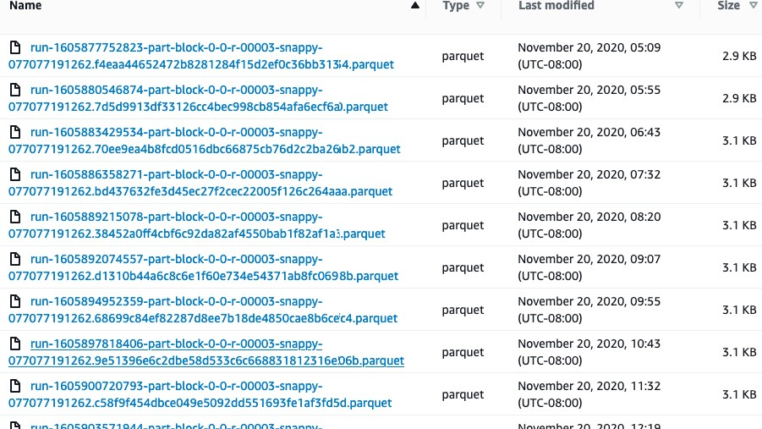
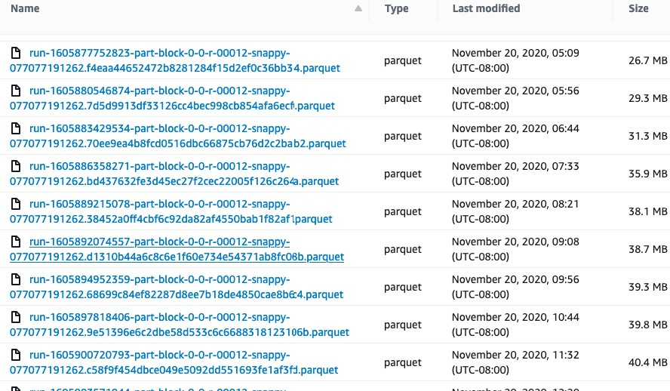
Storage optimizer benefits: File sizes
Smaller files means performance limited by I/O requests
Optimally sized for faster query performance

Slide 24
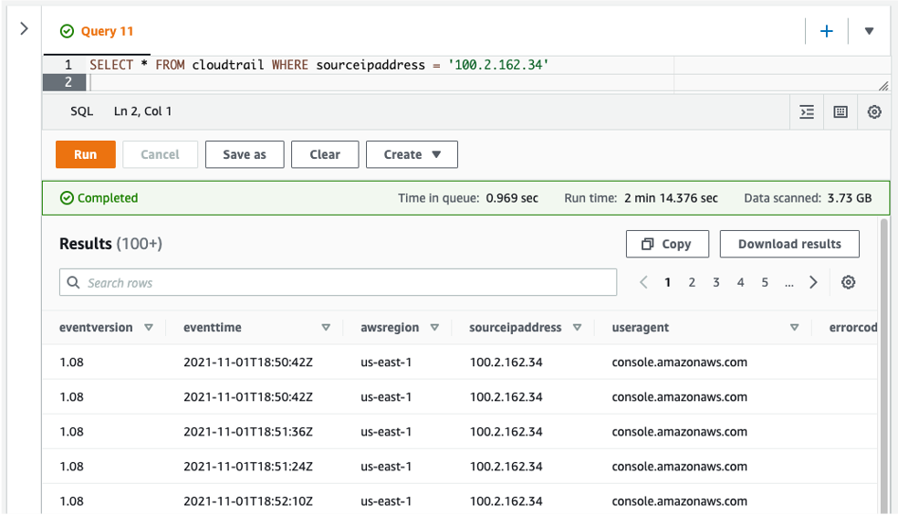
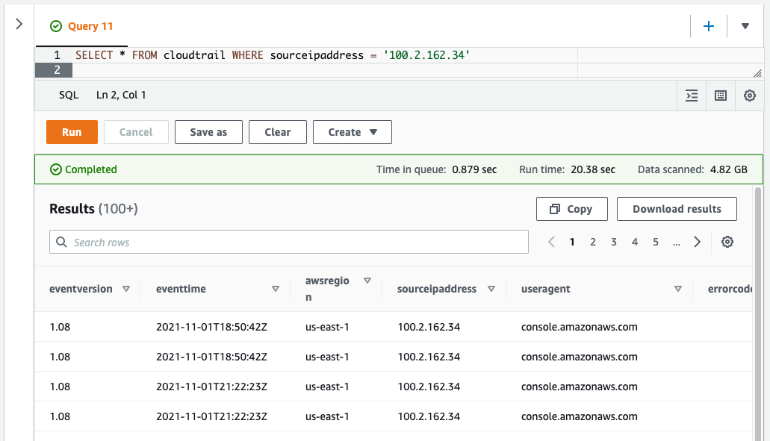


Storage optimizer benefits: Performance
Smaller files means performance limited by I/O requests
Optimally sized for faster query performance

Slide 25
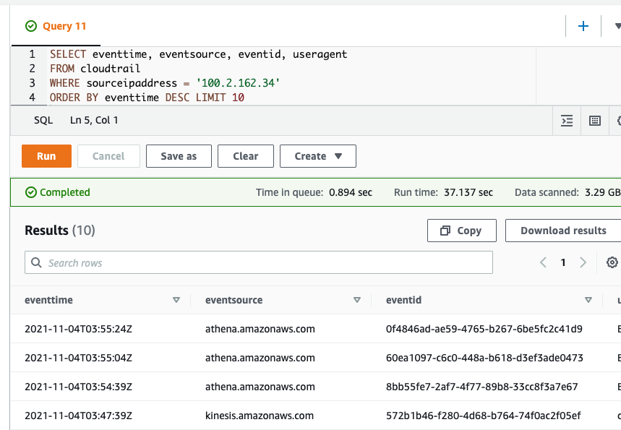
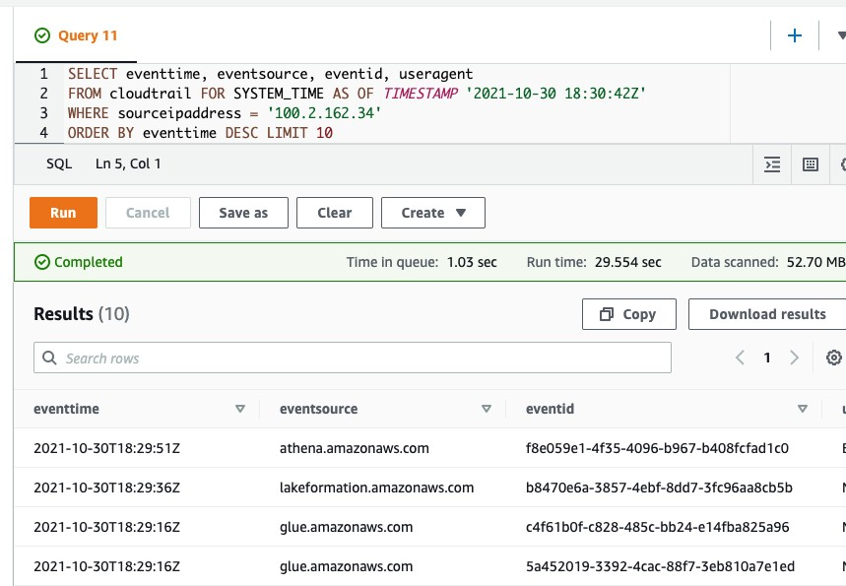
Example: Time travel
Query 1: result of query now
Query 2: Result of query “as of” last week

Slide 26


Transactions simplify development
““. . . Transactional ETL processes are an important part of how we ensure data integrity and . . . required additional development time and complexity. We’re excited about AWS Lake Formation Transactions’ ability to simplify our ETL and reduce the overall effort needed to produce trustworthy data in our data lake.”
Rob Hruska Engineering Director Hudl
“PowerBuy decided to forego traditional database-based architecture in favor of a data lake using AWS Lake Formation Governed Tables. Governed Tables make it easy to insert, update and delete data for all of our PowerBuy products using highly scalable ACID transactions. With Governed Tables we can release new products quicker like PowerBuy AI and PowerBuy Dashboard without worrying about scaling…”
Thu Truong
CTO and Co-Founder PowerBuy

Slide 27
Challenge: Integrated security & governance
AWS Glue ETL
On-premises
Streams
Amazon Redshift Spectrum
Amazon S3
AWS Glue Data Catalog
Amazon Athena
Databases
Logs
Amazon SageMaker
Amazon EMR
Challenge #3: Security & governance
Managing permissions at scale is difficult and error-prone.
Challenge #4: Integrations
Hard to securely integrating the service of your choice.

Slide 28






Why is managing data lake permissions hard
Unifying permissions
across the data lake stack
Enforcing fine-grained permissions to restrict access
Ensuring data access complies
with regulations
Analytics engine
Data Catalog
Storage
Split storage, metadata, and compute
Each system has different permissions Syncing permissions is error prone
Data lakes contain a lot of data
Users should only access portions 1,000s of resources and 10,000s of users
Democratize data access
Regulations and governance Monitor and audit data access

Slide 29











AWS Lake Formation permissions model
DB style fine-grained permissions on resources
Scale permissions management AWS Lake Formation Tag Based Access Control (LF-TBAC)
Unified S3 permissions Integrated with services and tools
Amazon S3 data lake storage
Easy to audit permissions and access

Slide 30
DB style fine-grained permissions on resources
DB style GRANT/REVOKE permissions Confer capabilities to principals on resources
Principals | Resources | Metadata permissions | Data Permissions
IAM users and roles | Catalog | CREATE_DATABASE | NA
SAML users and groups | Databases | CREATE_TABLE, ALTER, DROP | NA
 | Table | DESCRIBE, ALTER, DROP | INSERT, DELETE, SELECT
 | Data filters (row & cells) | DESCRIBE, DROP | SELECT
 | Columns | NA | SELECT
Delegate permissions management with the GRANTABLE option
Effective permissions for a principal are the union of all GRANTS

Slide 31
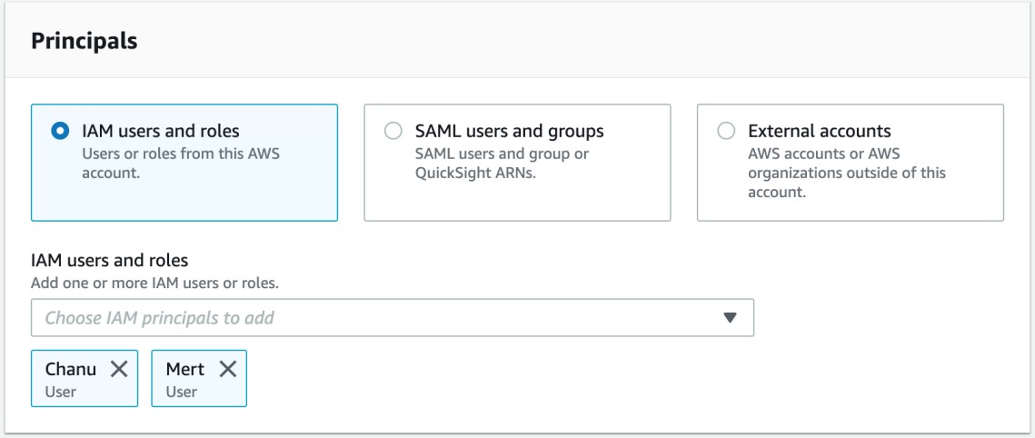
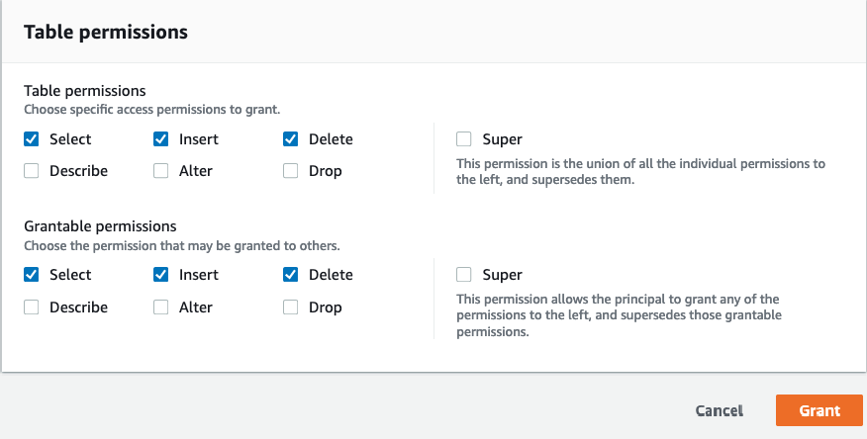
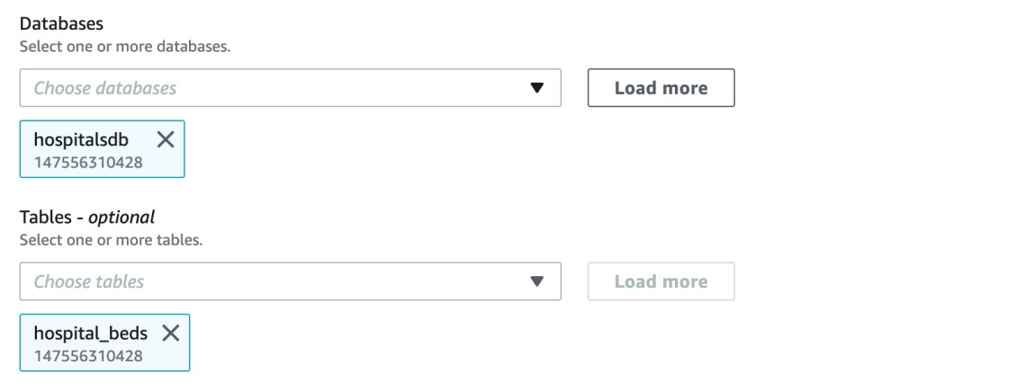
Setting up permissions
1. Specify the principals
3. Specify the exact permissions
2. Specify the resources

Slide 32
NEW!
AWS Lake Formation permissions on
Columns Rows
Cells
Specify include or exclude list
Specify row filter with PartiQL Combine column and row filters
Now GA, w/ support in
Amazon Athena, AWS Glue, and Amazon Redshift Spectrum

Slide 33
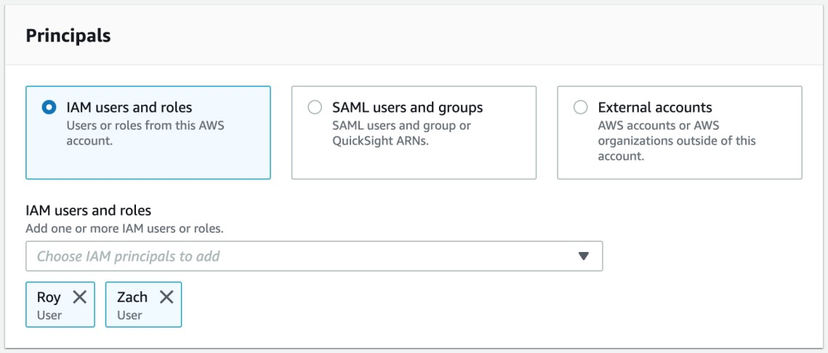
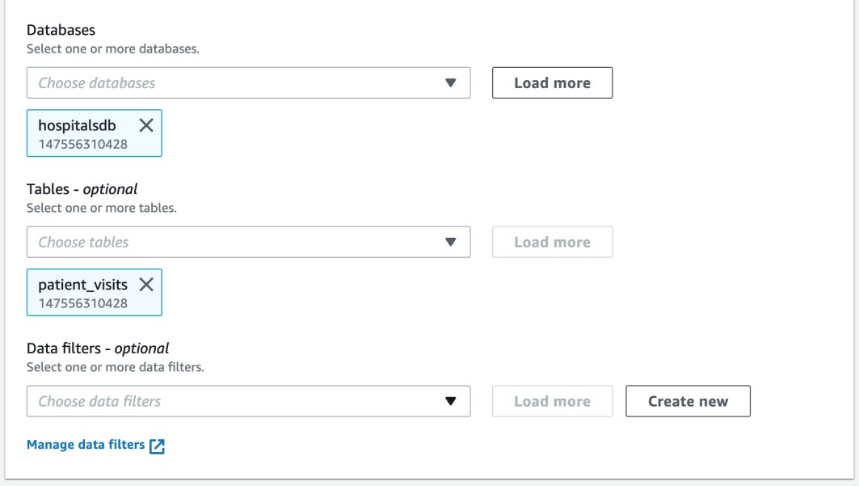
Setting up cell level permissions
NEW!
1. Specify the principals
2. Specify the resources

Slide 34
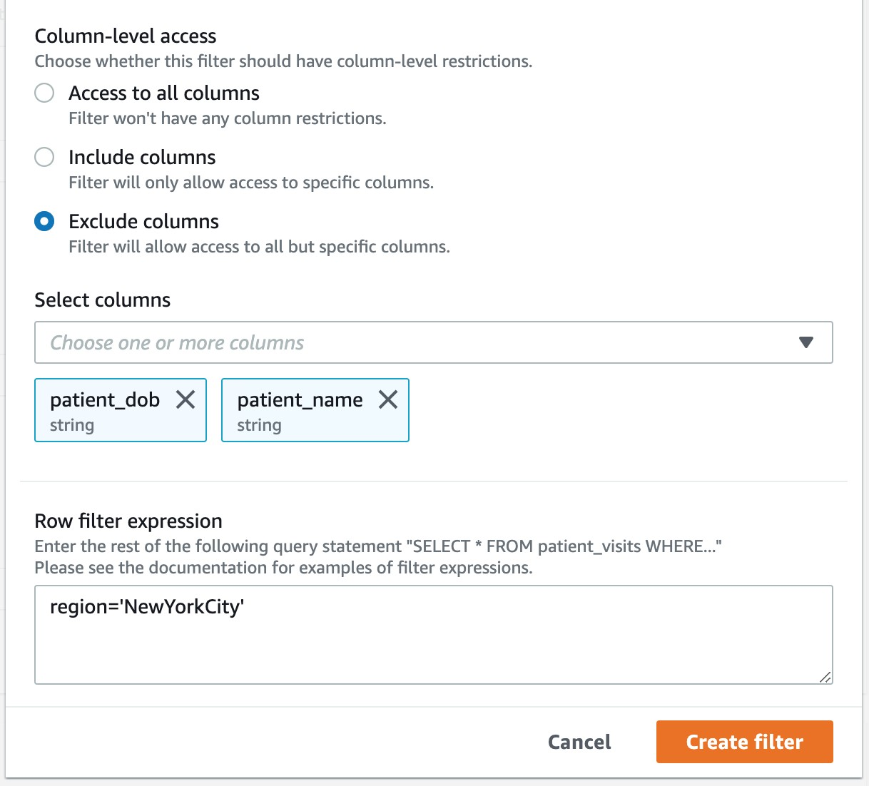
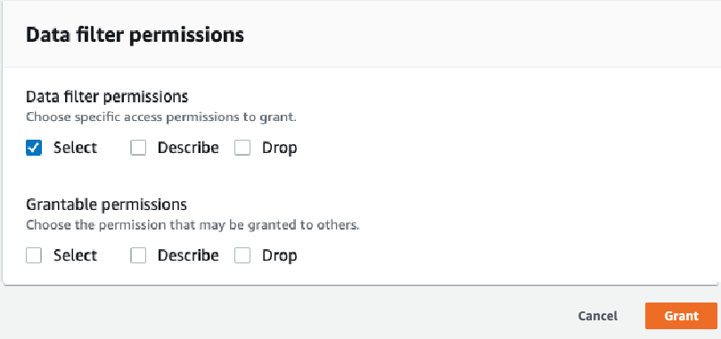
Setting up cell level permissions
NEW!
3. Create a data filter
4. Specify the exact permissions

Slide 35










Scale permissions management with LF–TBAC
NEW!
Define LF-Tags Assign LF-Tags to resources Create policies on LF-Tags
DBD:BW: SebalLeosgs
<stage>
 |  | <stage=Test>
 |  | <stage=QA>
 |  | <stage=Prod>
IAM user/role
AD users and groups
(SAML assertion)
Specify who can assign LF-Tags and values
Tag databases, tables, columns
LF-Tags are hierarchical and
may be overridden
Scale by applying permission
on LF-Tags
© 2021, Amazon Web Services, Inc. or its affiliates. All rights reserved.

Slide 36
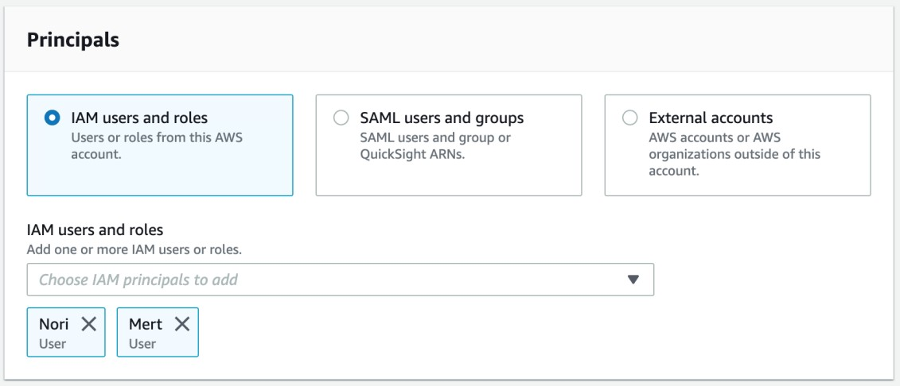
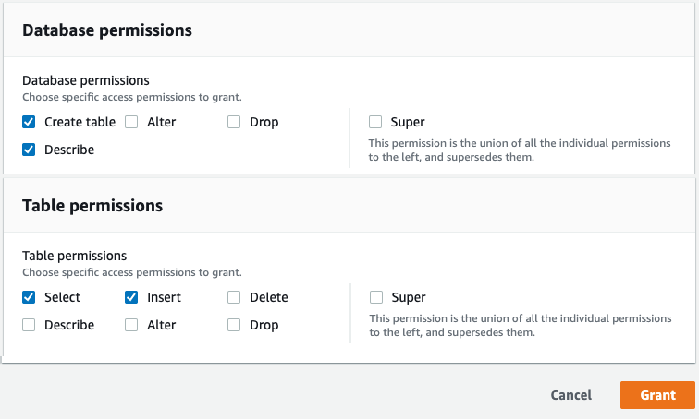
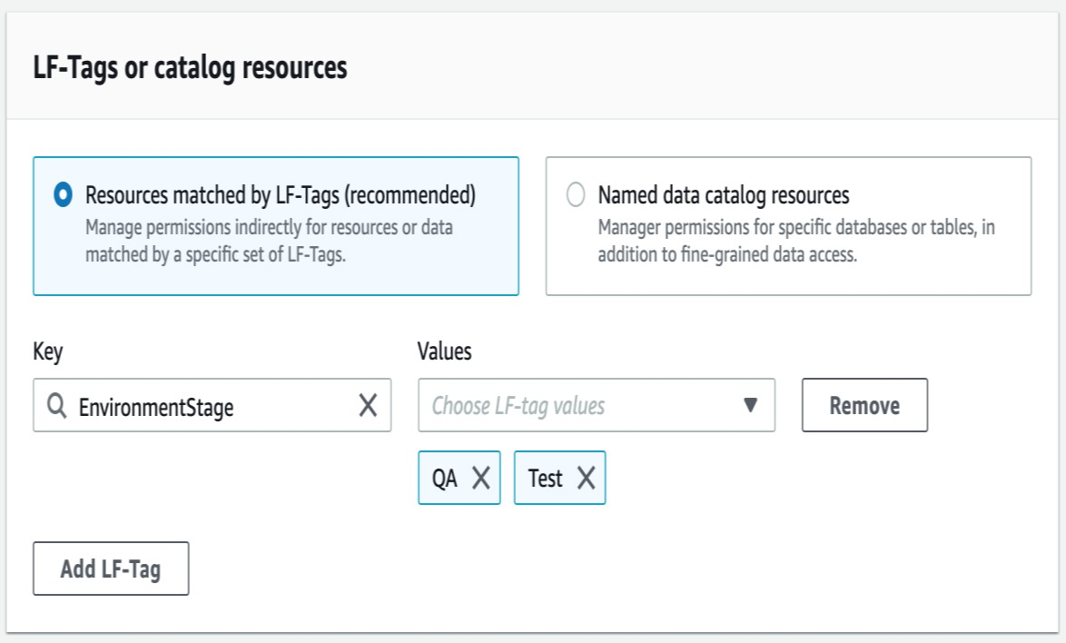

Setting up LF-TBAC permissions
NEW!
1. Specify the principals 3. Specify the exact permissions
2. Specify the tags

Slide 37
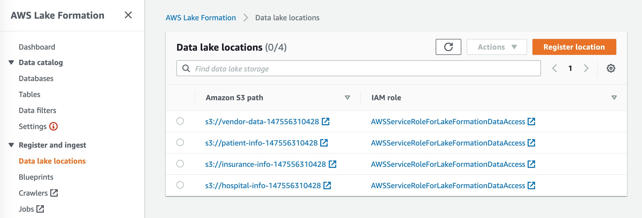
AWS Lake Formation unifies S3 permissions
AWS Lake Formation can vend credentials for registered locations

Slide 38









Integration option #1: LF credential vending
DATA SECURITY
OFFICER
Trusted services
2
Check authorization for principal
Return temporary
credentials
3
AWS
Lake Formation
1 Query T
Amazon Redshift
AWS
Glue
User
4 Request objs comprising T
Amazon EMR
Amazon Athena
Return objs comprising T
5
Amazon S3
6

Slide 39
NEW!
Integration option #2: LF Storage API
DATA SECURITY
OFFICER
Integrated services
L F S A
2
Read data
AWS
Lake Formation
1 Query T
Amazon Redshift
AWS
Glue
User
Filtered data
3
Amazon EMR
Amazon Athena
Amazon S3
Third-party Apps
Custom Apps

Slide 40
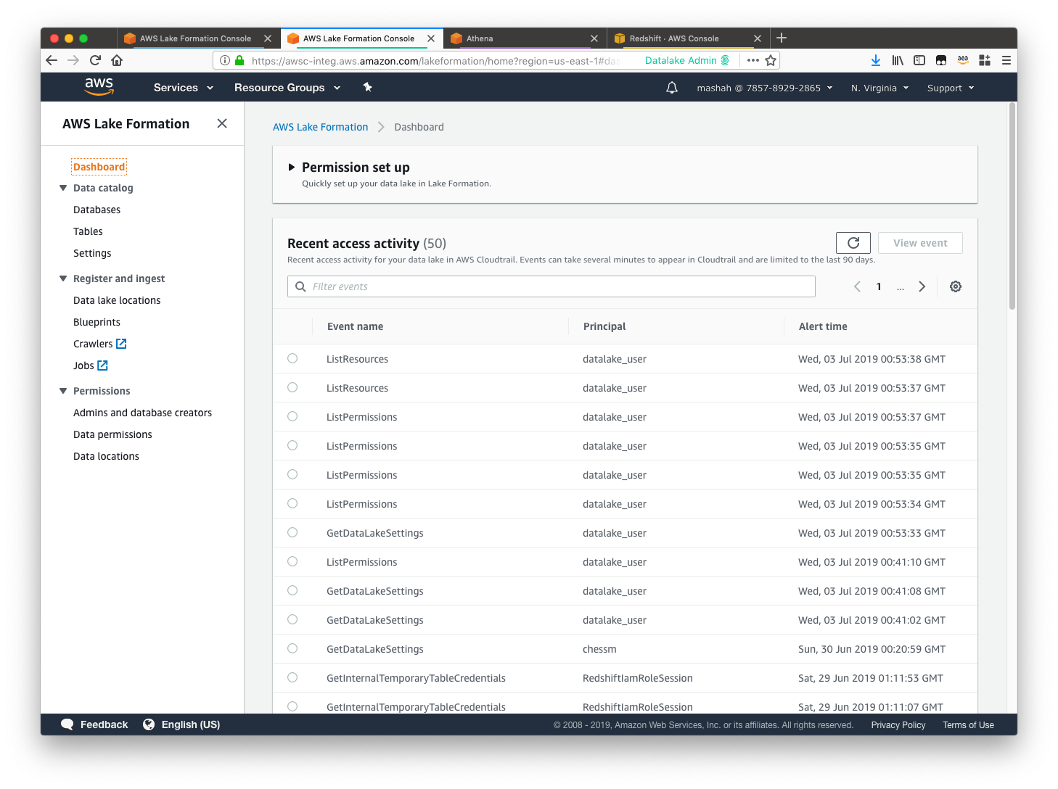
Audit and monitor in real time
DATA SECURITY
OFFICER
All event logs stored in
AWS CloudTrail
Integrate with your existing auditing and monitoring systems.
Integrated dashboard to monitor in real time

Slide 41
Securing data lakes
“. . . security of highly confidential consumer data has always been our top priority to manage data in an integrated way and build a data lake on AWS . . . By leveraging AWS Lake Formation, we were able to catalog all kinds of data, properly control access to sensitive data and build large-scale secure data lakes in a short period of time.”
Naoko Endoh
Vice President, Head of Global IT Macromill, Inc
“AWS Lake Formation enables us to create a secure Data Lake with fine-grained controls on our user’s personal information. Our Analysts can now deliver much needed insights, much faster without compromising the governance and security policies.”
Damian Grech
Data Engineering, Sr. Manager FanDuel

Slide 42
Challenge: Data sharing
Challenge #5: Data sharing
Sharing across accounts and organizations is cumbersome.
AWS Glue ETL
On-premises
Streams
Amazon Redshift Spectrum
Amazon S3
AWS Glue Data Catalog
Amazon Athena
Databases
Logs
Amazon SageMaker
Amazon EMR

Slide 43












Why is sharing data across accounts hard
Producer
Consumer
Producer
Consumer

Slide 44






AWS Lake Formation cross-account sharing
Producer
Consumer
Sales
Opportunities
Data catalog
Sales
Opportunities
AWS Lake
Formation
Data catalog
eu_sales eu_opps
Producer GRANTs permissions to consumers’ account Consumer’s data lake admin configures permissions Consumer “soft links” shared resources
Analytic engines utilize “soft links” as before
Amazon Athena
AWS
Glue
Amazon EMR
Amazon
Redshift

Slide 45
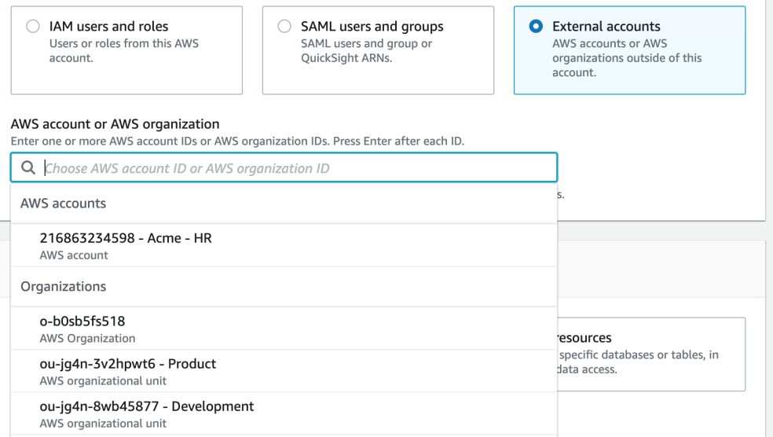
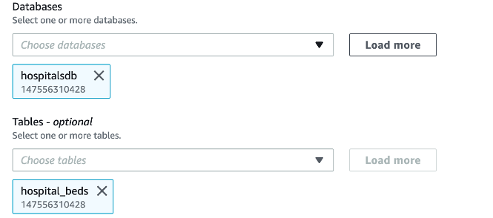
Setting up LF cross account sharing
NEW!
1. Specify the principals (account) 3. Specify the exact permissions
2. Specify the resources
Share with accounts, organization,
organization unit, or external accounts

Slide 46

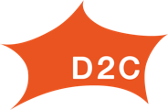
Sharing data lakes across accounts
“. . . We are building a hub-and-spoke architecture using AWS Lake Formation where data producers can publish their sharable data to a centralized data catalog and data subscribers can request access to that data from the centralized data catalog.”
Charles Beadnall CTO
GoDaddy
“. . . To work on the data lake with multiple AWS accounts, we need a central metadata catalog . . . Using the cross account database/table sharing of AWS Lake Formation, we are able to achieve our goal easily, without affecting the existing workload . . . the ability to manage data by column enables more
sophisticated data management.”
Rinichiro Nagatomo Technical lead
Data management platform
D2C Inc.

Slide 47
AGENDA
Why data lakes
Challenges with building data lakes AWS Lake Formation overview
Why JPMorgan Chase chose AWS Lake Formation
How JPMorgan Chase built a data mesh using AWS Lake Formation Conclusion

Slide 48

About JPMorgan Chase
D E L I V E R I N G A T A G L O B A L S C A L E
$31T
in assets and operations worldwide
450+
Petabytes of data
250K
Virtual workspaces
55M
Active digital customers
50%
or 63M U.S. households have a relationship with Chase
>80%
of Fortune 500 companies do business with JPMC
>100
presence in
markets globally
$8T
in payments processed daily
50K+
Technologists
6.5K+
Applications

Slide 49


Modernizing in the cloud
W H Y B U I L D I N G A D A T A L A K E U N L O C K S O P P O R T U N I T Y A N D
B U S I N E S S
V A L U E
Democratize data
Data speed
Governance and control
Do it all
at scale

Slide 50

Business needs drive technology evolution
T H I N K I N G H O L I S T I C A L L Y T O B U I L D A N E F F I C I E N T M O D E R N D A T A P L A T F O R M
Cost Savings
Business Value
Data Sharing
Match business needs to data domains. Maximize data reuse and improve ownership and accountability
Identify opportunities to reduce infrastructure cost and improve accessibility and time to insight
Identify opportunities to unlock business value by eliminating friction and enabling ubiquitous access to data
Accelerate time to insight
Reusable data domains
Common tech stack & lower costs
Ubiquitous access
Data Lake as the source of truth

Slide 51






The Data Mesh pattern
E X P A N D I N G B E Y O N D T H E T R A D I T I O N A L D A T A L A K E
Source
Relational Databases
Hadoop Clusters
Files
APIs
Ingestion
Services
Orchestration
Meta Data
Management
Data
Catalog
Telemetry
Security
Data
Federation
Consumption
Source
Reporting
Ops
Self-Serve Data Infrastructure Services
DBA
Data
Analyst
Product 1
Product 2
Product 3
Analytics
AI / ML
E
T
L
E
T
L
_{E} Data _{er}
Data
E
T
L
ngine
Scientist
Product 4
Product 5
E T
Hybrid Lake Consumption
E
T
L
L
Data Access
On-Premise
Loosely Coupled Architecture
Data Lake
Data Lake
Decoupled Compute/Storage
Elasticity
Data as Products
Engine
Key Benefits
E n a b l e d o m a i n d a t a a s a p r o d u c t
E a s i l y e n a b l e f i n e - g r a i n e d e n t i t l e m e n t s
D a t a i s e a s i l y c o n s u m a b l e
C r o s s - e n t e r p r i s e v i s i b i l i t y o f d a t a c o n s u m p t i o n
F e d e r a t e d d a t a g o v e r n a n c e a n d c o m p l i a n c e

Slide 52
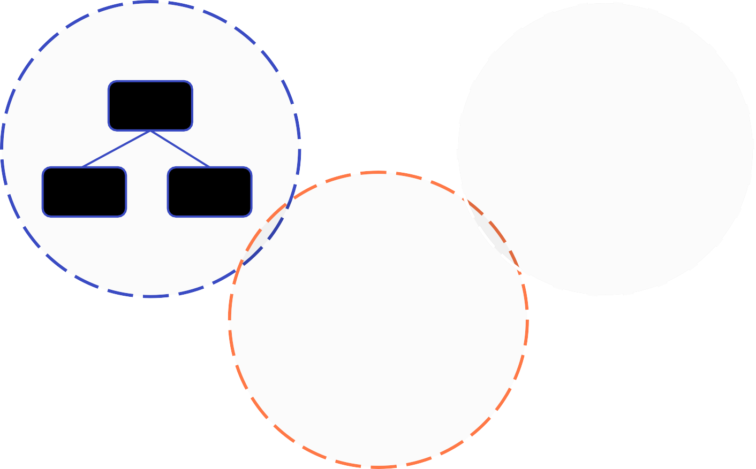
Product thinking
A N D W H A T T O C O N S I D E R W H E N B U I L D I N G A D A T A M E S H
Establish and align on common taxonomy and terminology for data as products
Align the needs of consumers with roughly right data products
Apply domain driven design techniques to formulate and establish bounded contexts for data products
Performance considerations may drive tradeoffs to loosen bounded context
Learn by doing and evolve
Bounded
Context
Bounded
Context
Wholesale Credit Risk
Credit Exposure
General Reference Data
Country
Bounded Context
Credit Grading
Credit Facility
Currency
Geography
Party
Products & Services
Party
Business Unit
KYC
Customer

Slide 53
AGENDA
Why data lakes
Challenges with building data lakes AWS Lake Formation overview
Why JPMorgan Chase chose AWS Lake Formation
How JPMorgan Chase built a data mesh using AWS Lake Formation
Conclusion

Slide 54
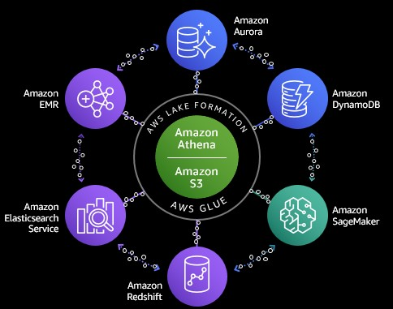








Next evolution of our data lake
E X T E N D I N G T H E D A T A L A K E F O L L O W I N G T H E D A T A M E S H D E S I G N P A T T E R N
Consumer bank
Line of business autonomy
Enterprise data products
Corporate technology
Federated governance
AWS Lake Formation
Corporate investment bank
Central data discovery

Slide 55
Ownership and accountability
D A T A O W N E R S A R E A C C O U N T A B L E F O R T H E I R D A T A P R O D U C T S T O B E R E L I A B L E , A V A I L A B L E A N D A C C U R A T E
Accountability for data product
Owns data created or transformed
in my product
Classifications, metadata, and
^{Create} descriptions
Quality of data
Owns data stored in my product
Access entitlements
Consume | Owns how my product uses the data Get data from the right place Verify quality and fit for purpose Comply with use restrictions
Data retention / destruction
Recovery and location requirements
Store
Product
Product
A
Product
C
Owner Product A
B
Receive data
Provide data
Accountability for data exchanges
When Receiving data, source is accountable for
Classifications, metadata, and descriptions
Quality of data
Receive data
Execute a complete and timely data exchange
When sharing data with other products, must
Comply with data sharing restrictions
Provide data only where the product is the
^{Share data} authoritative source
Execute a complete and timely data exchange
8

Slide 56


















Line of business consumer banking
AWS Account 2
On-premises data center
Data product
AWS Account 1
Data consumer
Streaming layer
Amazon MSK
Kafka
AWS
DataSync
Amazon Athena
Amazon SageMaker
Amazon Redshift
Amazon EMR
Amazon QuickSight
Central catalog and
entitlement
Data lake
Metadata layer
AWS Glue crawler
AWS Glue Data
Catalog
On-premises Active Directory
AWS Lake Formation
Raw
Trusted
Data Data Data analyst scientist engineer
Processing Layer
Amazon EMR
AWS Glue ETL
Consumer: Classified
Consumer: Public
Workflow layer
AWS Step Functions
AWS Lambda

Slide 57
Managing data products
Single LOB – one or more data products
Data products comprise of owner, processes, and data pipelines
Multiple data consumers, internal and external to the LOB
Lake Formation to share data products with consumers
Lake Formation for fine-grained permissions on data products
Lake Formation tags to manage permissions at scale
JPMorgan Chase needs to maintain hundreds of data products across many lines of business

Slide 58



Line of business – Consumer banking
Consume a data product
Line of business – Commercial banking
Data product 3
AWS Lake Formation
Data Catalog
JPMorgan Chase Central LF Account
Consumer: Public
Lake Formation Data Catalog
Consumer: Sensitive
Data product 2
AWS Lake Formation
Data Catalog
Raw
Trusted
Internal data consumer
Commercial: Public
Lake Formation Data Catalog
Commercial: Sensitive
Lake Formation Data Catalog
Internal data consumer
Lake Formation Data Catalog
Amazon QuickSight Redshift
AWS Lake Formation
Data Catalog
Raw
Trusted
Amazon EMR
Refined
Consumer: Public
Consumer: Sensitive
Commercial: Public
Commercial: Sensitive
Each LOB owns and manages its own data products
Controls entitlements, audit usage and share data as appropriate
The JPMorgan Chase Central Catalog provides a view into all data products
It does not allow granting or revoking access to any dataset

Slide 59
Key benefits gained by building Data Mesh
Provides central governance and entitlements
Enables diverse topologies that scale with the organization
Easily share between LOBs using tags and cross account
Robust integration with AWS native services and third parties

Slide 60
AGENDA
Why data lakes
Challenges with building data lakes AWS Lake Formation overview
Why JPMorgan Chase chose AWS Lake Formation
How JPMorgan Chase built a data mesh using AWS Lake Formation
Conclusion

Slide 61
With AWS Lake Formation
BUILD A SECURE DATA LAKE IN DAYS
AWS Glue ETL
On-premises
Streams
Amazon Redshift Spectrum
Amazon S3
AWS Glue Data Catalog
Amazon Athena
Databases
Logs
Amazon SageMaker
Amazon EMR
https://aws.amazon.com/lake-formation/

Slide 62

Thank you!
Chanu Damarla (he/him)
Principal Product Manager AWS Lake Formation
Amazon Web Services
James R Reid (he/him)
CIO of Employee Experience and Corporate Technology
JPMorgan Chase
Anu Jain (she/her)
MD of Consumer & Community Banking
JPMorgan Chase
© 2021, Amazon Web Services, Inc. or its affiliates. All rights reserved.

